Slide 1
HNG DATA ANALYSIS INTERNSHIP
MARKETING PERFORMANCE ANALYSIS REPORT
Prepared by: Adediran Adeyemi (D-Analyst)

Slide 2
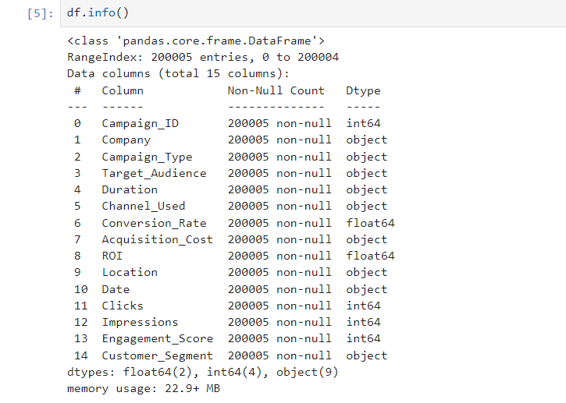
Introduction
Image showing the dataset information
This report provides a comprehensive analysis of our recent marketing campaigns, highlighting key performance metrics, identifying critical issues, and offering actionable recommendations. The insights are based on a dataset of 200,005 campaigns across multiple companies, channels, and customer segments. The objective is to maximize ROI while improving conversion rates and customer engagement across all channels. Key data observations:
Data Types : Some columns, such as Duration, Acquisition_Cost, and Date, are currently stored as object types and may require preprocessing (e.g., converting to numeric or datetime formats).
Numerical Features : Columns like Conversion_Rate, ROI, Clicks, Impressions, and Engagement_Score provide quantitative measures of campaign performance.
Categorical Features : Columns like Campaign_Type, Channel_Used, Location, and Customer_Segment allow for segmentation and grouping of campaigns

Slide 3
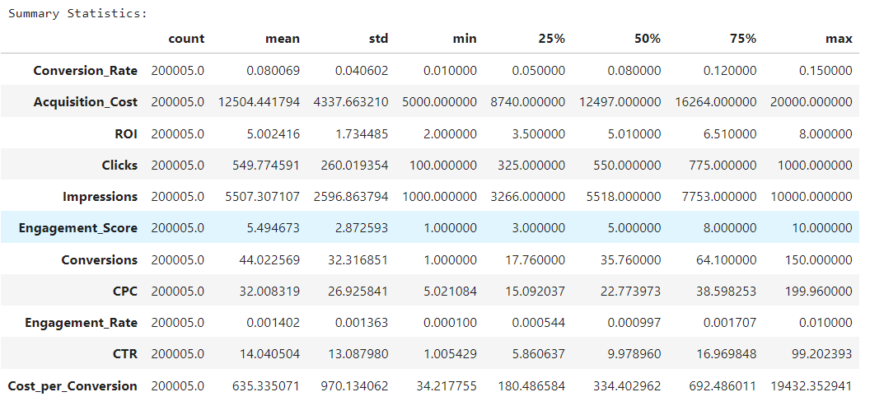
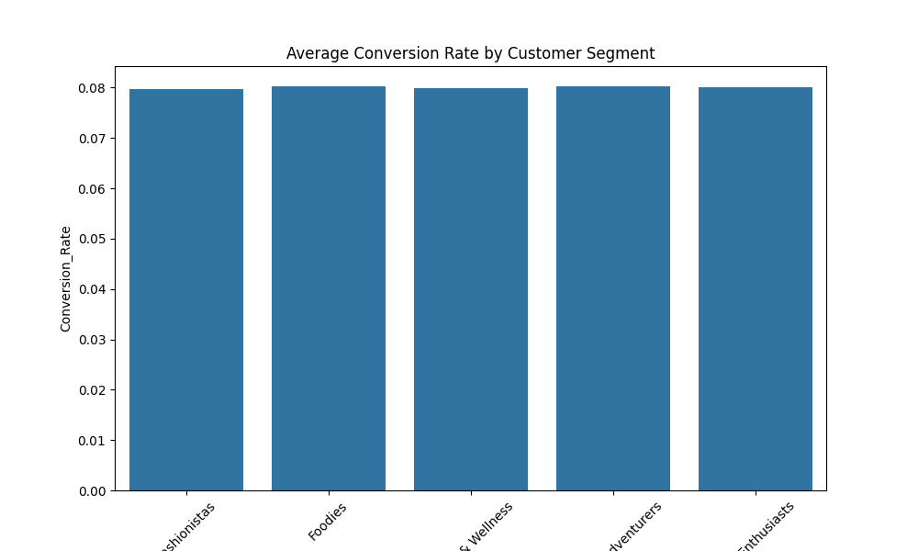
Findings & insights
Table showing the summary statistics
The analysis of 200,005 marketing campaigns reveals a mixed performance landscape. While the average ROI of 5.0 and conversion rate of 8.01% are positive, significant inefficiencies are limiting profitability. Key issues include:
High cost per conversion variability, with some campaigns costing up to $19,432 per conversion.
Low engagement rates (mean: 0.14%), indicating content is not resonating strongly with audiences.
No statistically significant differences in ROI across campaign types, channels, locations, or customer segments, suggesting untapped optimization opportunities.
Top Performers:
Customer Segment: "Foodies" (8.03% conversion rate, 5.00 ROI).
Campaign Type: "Influencer" (5.01 ROI, $631.66 cost per conversion).
Channel: "Website" (14.10 CTR, $31.78 CPC).
Bar chart showing avg. conversion rate by customer segment

Slide 4
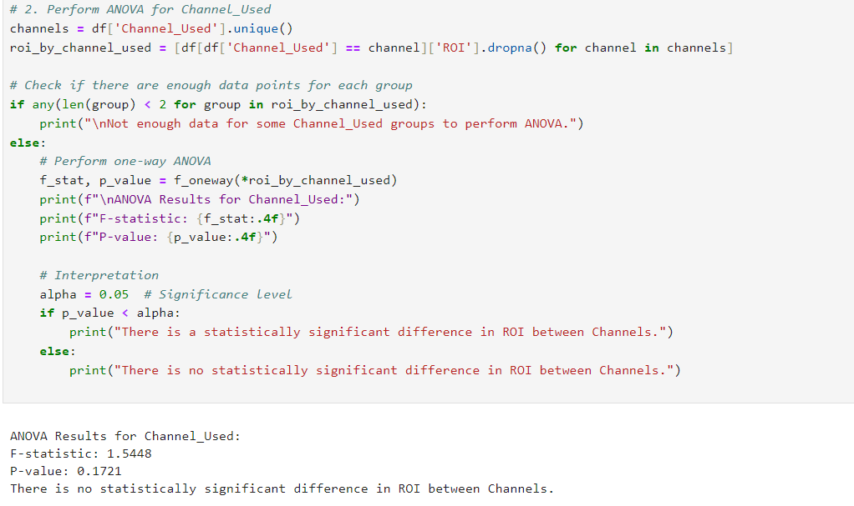
Code & Methodology
The analysis was conducted using a structured approach to ensure accuracy and reliability of insights.
Data Cleaning: No outliers or missing values were identified in the dataset.
Standardization: Columns for Duration, Date, and Acquisition_Cost were standardized to ensure consistency.
KPI Calculation: Key performance indicators such as CPC, CTR, and Cost per Conversion were calculated based on available data points.
Descriptive Statistics: Summary statistics (mean, standard deviation, min, max) were generated for all relevant metrics to understand central tendencies and variability.
Correlation Analysis: A correlation matrix was created to evaluate relationships between key variables, including Conversion Rate, ROI, CPC, and Engagement Score.
Segment Analysis: Data was segmented by Location, Channel_Used, Target_Audience, and Customer_Segment to identify high-performing groups and areas for improvement.
ANOVA Analysis: Statistical tests were performed to assess significant differences in ROI across Campaign Types, Channels, Locations, and Customer Segments.
Code showing ANOVA result for channel used

Slide 5
Recommendations
To refine our targeting strategies, we will focus on the "Foodies" segment, which has an impressive 8.03% conversion rate and a 5.00 ROI. We'll re-evaluate the targeting for "Women 35-44" given their similar performance with an 8.01% conversion rate and 5.01 ROI. Additionally, we plan to test hyper-targeted campaigns for "Men 18-24" to improve conversion rates, as this group currently has a strong CTR of 14.05.
Optimizing the channel mix will involve reallocating more budget to "Website" campaigns, which have a 14.10 CTR and a $31.78 CPC. In contrast, we'll reduce spending on "Google Ads," which shows slightly lower performance with a 13.92 CTR and a $32.31 CPC. We also plan to leverage "Influencer" campaigns, as they show promising results with a 5.01 ROI and a cost per conversion of $631.66.
To enhance content engagement, we will invest in more creative content, as our engagement rate is currently 0.14%. A/B testing ad creatives for both "Foodies" and "Tech Enthusiasts" will help optimize messaging. We'll also focus on personalizing content for "Women 25-34," who show high engagement potential with a 7.99% conversion rate.
For ongoing monitoring and budget allocation adjustments, we will track the cost per conversion and ROI by channel, campaign type, and segment. Budgets will be shifted toward campaigns with a cost per conversion below $635.34, such as "Social Media" ($629.90). Additionally, we will implement a cost per conversion cap to prevent overspending on underperforming campaigns.

Slide 6
Conclusion & Next Steps
Our marketing campaigns are performing well, with an average ROI of 5.0 and a conversion rate of 8.01%. However, there are inefficiencies in targeting, channel allocation, and customer engagement that present opportunities for improvement. By addressing these challenges, we can lower costs, increase customer engagement, and achieve higher returns.
The immediate focus should be on conducting an in-depth analysis of the successful "Foodies" segment to replicate their success across other campaigns. Additionally, a pilot program will be launched to test hyper-targeted messaging aimed at "Men 18-24" and "Women 35-44.“
In the short term (1-2 months), we will develop a content calendar designed around high-engagement themes for key demographics. A task force will also be established to monitor and optimize underperforming campaigns in real-time.
For ongoing monitoring, we will implement a dashboard to track key performance indicators such as cost per conversion, CTR, and ROI, broken down by segment and channel. Bi-weekly reviews will be scheduled to assess progress and adjust strategies accordingly.
Looking ahead to the long term (3-6 months), we will invest in advanced analytics tools to enhance our ability to predict customer behavior and campaign outcomes. A cross-functional team will also be formed to align marketing efforts with sales and product development, ensuring a cohesive customer journey.

